Slide 1

Notes:
Lost in Translation is considered to be - by its director Sofia Coppola - a “study in emotional and geographical dislocation”.

Slide 2
Contemporary Residential Transience:
Specificities in its Domestic and Urban Appropriation
How can 1 quote and 3 films effect design decisions

Slide 3
“I've always been fascinated with nomads,
Precisely because they don't travel.
Those who travel are emigrants.
But nomads don't travel.
To the contrary, they stay immobile.
It's because they don't want to leave
that they seize hold of the earth, their land.
Their land becomes deserted and they seize hold of it.
They can only nomadize their land.
So, in a sense, nothing is more immobile than a nomad.”
Gilles Deleuze

Slide 4
Lost in Translation (2003)
Notes:
“Lost in Translation” is considered by its director, Sofia Coppola, to be a “study in emotional and geographical dislocation”

Slide 5
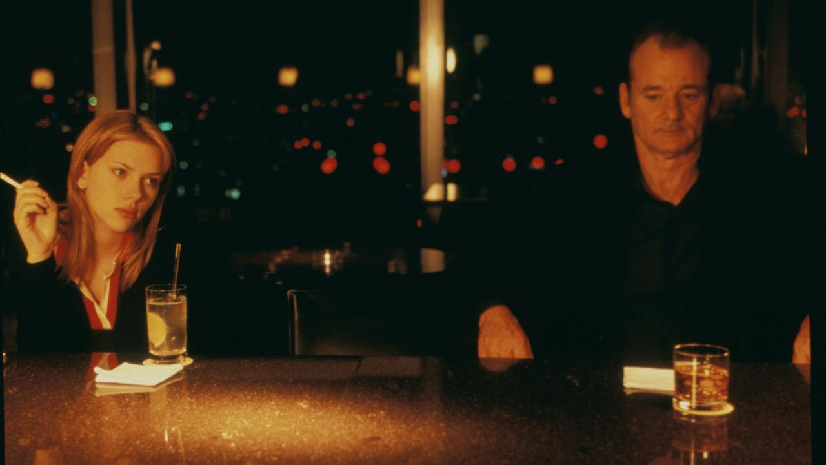
Notes:
The movie shows us the lives of two individuals who are disconnected and lost in what is a very hectic city: Tokyo.
Scarlett Johansson's character - Charlotte - is a young graduate student who is left alone in a hotel room by her husband – himself a sort of residential transience figure - who is a photographer. She runs into star Bob, a famous actor – played by Bill Murray – who also staying in the same hotel.

Slide 6
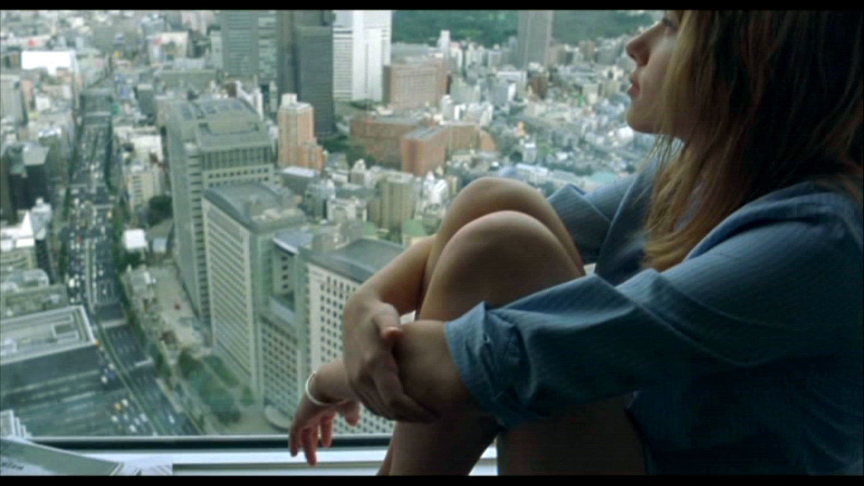
Notes:
The movie shows us the life of two individuals who are dislocated and lost in what is a very hectic city: Tokyo.
Scarlett Johanssen's character - Charlotte - is a young graduate student who is left alone in a hotel room by her husband who is a photographer. She runs into star Bob, a famous actor – played by Bill Murray – who also staying in the same hotel.

Slide 7
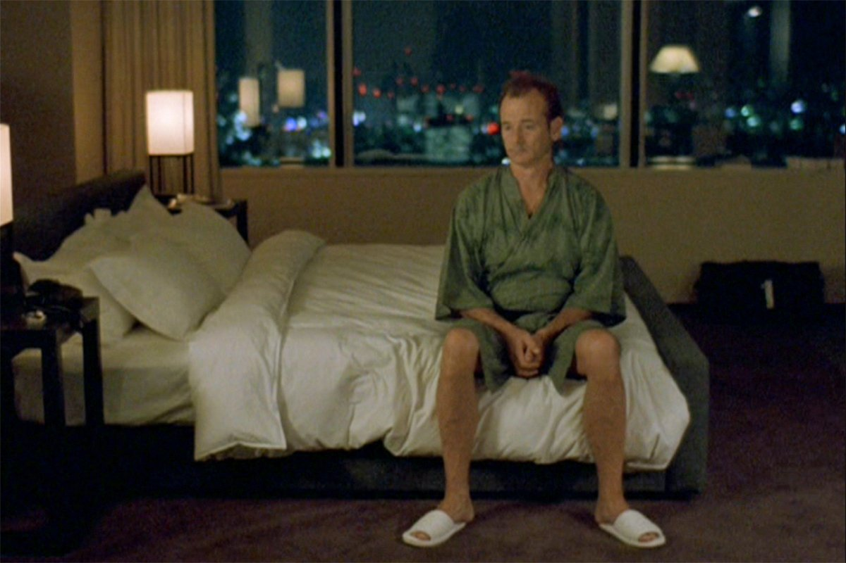
Notes:
They rarely inhabit the their own room.
They are only there for the sole of sleeping.
In fact, the rooms end up being places of loneliness and anguish.

Slide 8
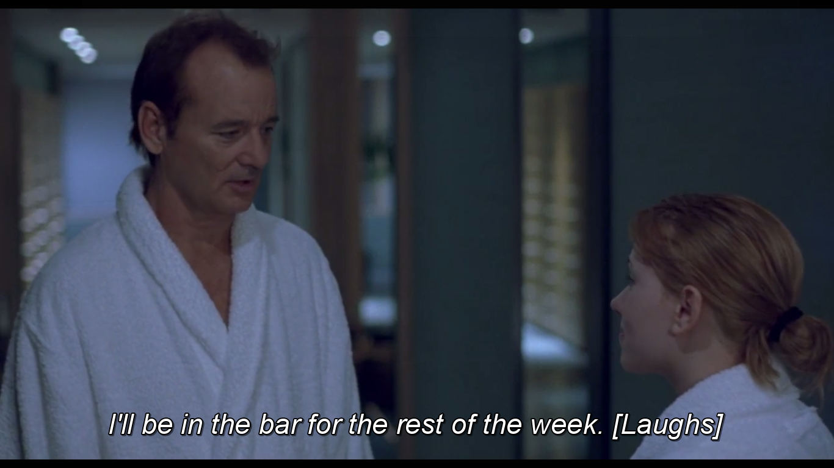
Notes:
Rendezvous happen anywhere in the hotel.
In the hallways, lobbies, pools and bars,

Slide 9
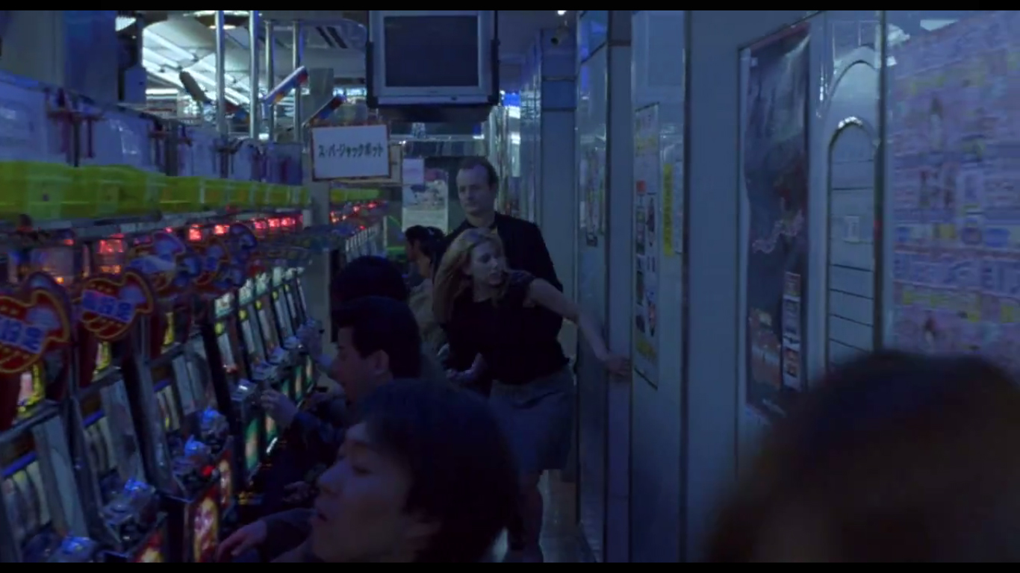
Notes:
But also outside. In amusement arcades,

Slide 10
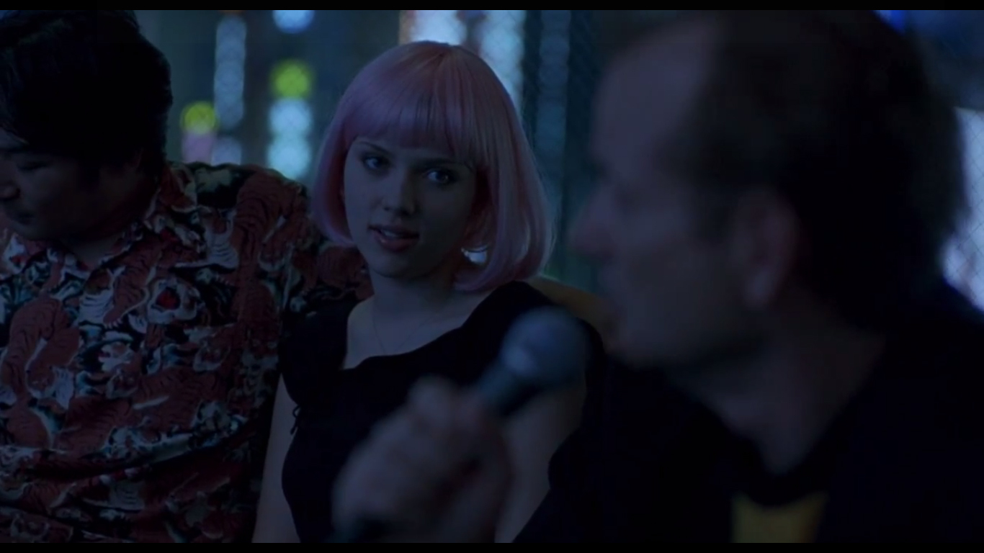
Notes:
in karaoke bars (that resemble tiny apartments), strip clubs, and even hospitals.

Slide 11
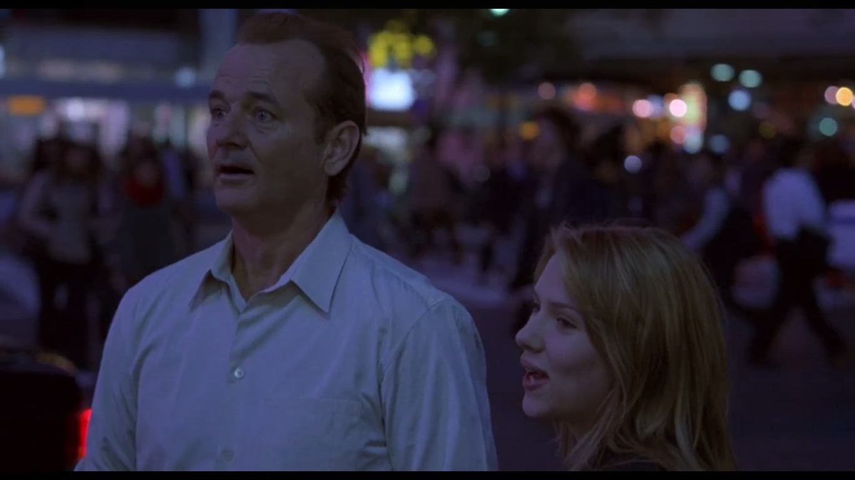
Notes:
The accentuation of the inversion of public and private spaces/activities is notorious for this very short period of time. They live outside with intensity.

Slide 12
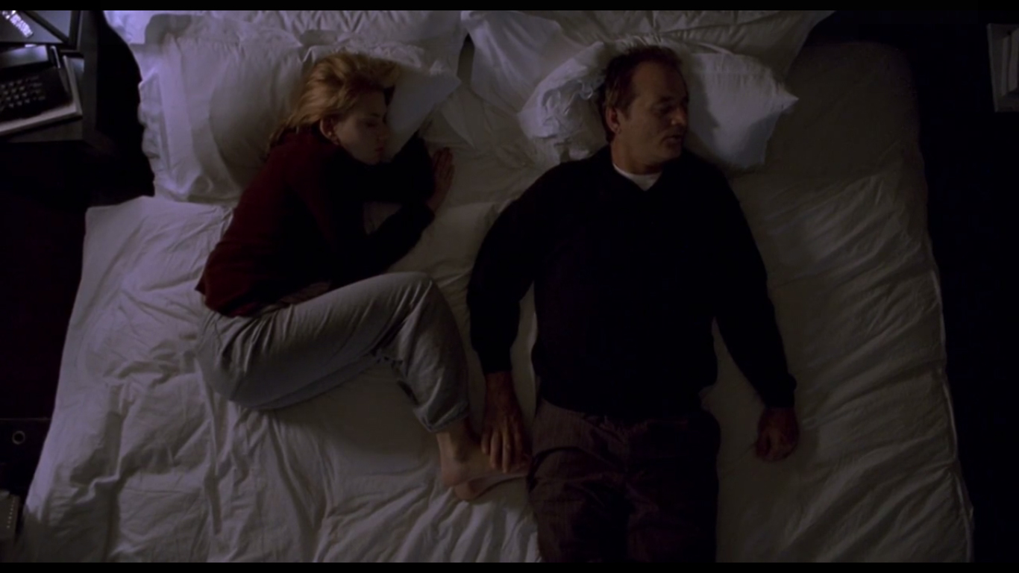
Notes:
In this city, and for this time, these figures of residential transience, free themselves of an obligation of a structured life and behaviour, allowing serendipity to occur.

Slide 13
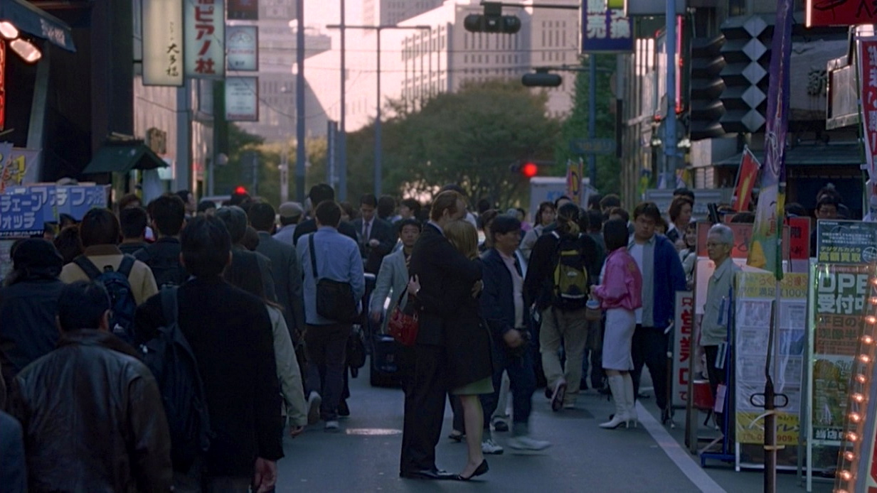
Notes:
Two people who were disconnected in this very huge city, take advantage of two important elements – the semi-private spaces of the hotel and the of public and semi-public spaces of Tokyo – in order to embrace one another finding a meaning to an apparent isolation in this very different territory and culture.

Slide 14
Up in the Air (2009)
Notes:
Up in the air is a movie that was released only one year after the financial crisis of 2008.

Slide 15
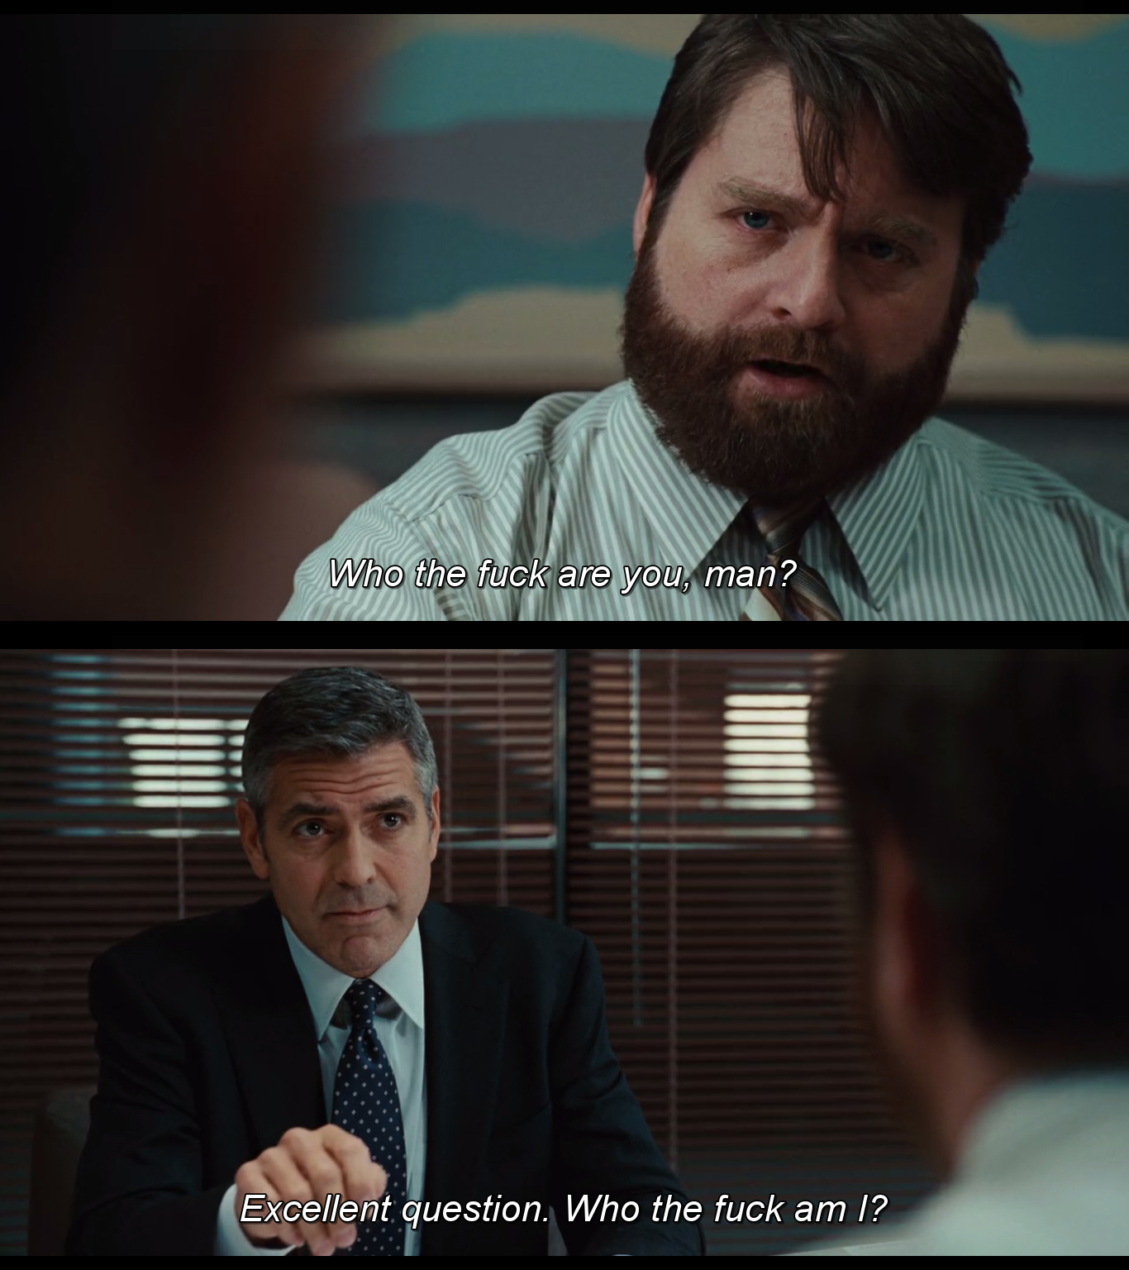
Notes:
It tells us the story of a man – Ryan Bingham – who travels around the US to give people the terrible news that they have been fired, a consequence of massive company layoffs in the post-crisis period.

Slide 16
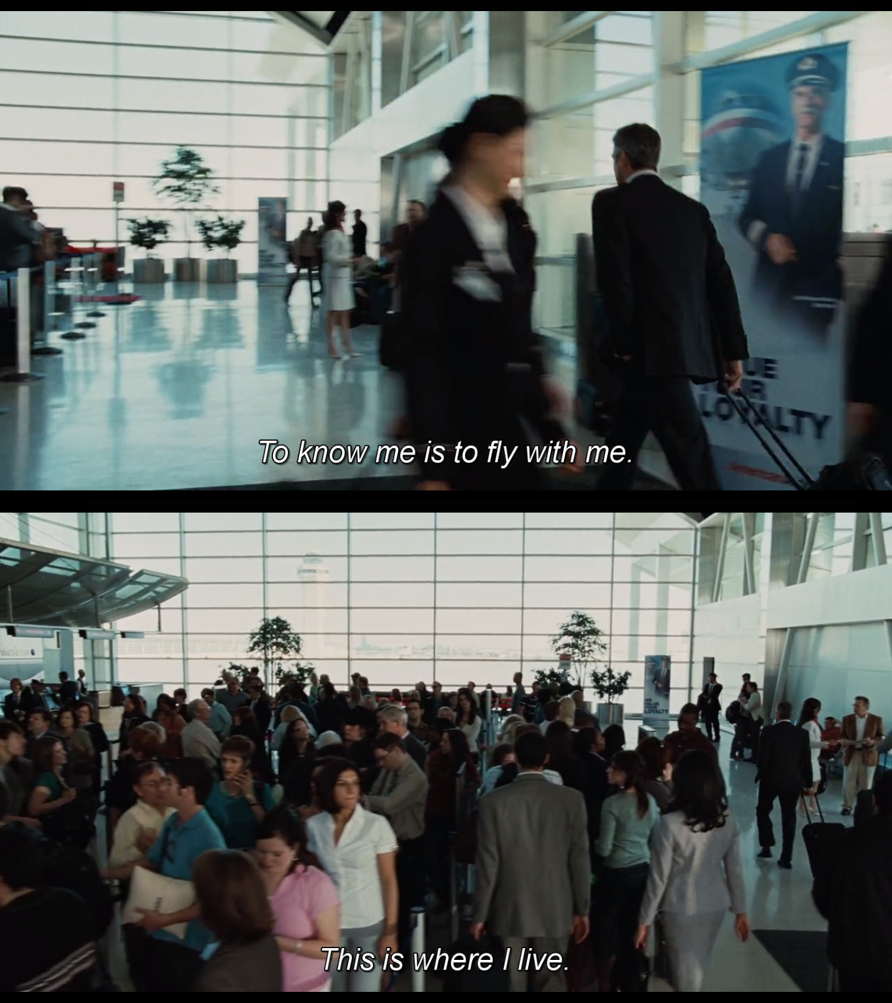
Notes:
Like many people, what he does and who he is is deeply connected.
Being always on the run, his life goal is being one of 7 people to hit the 10 million miles flyer mark.
That has enormous effect in his social apprehension of reality

Slide 17
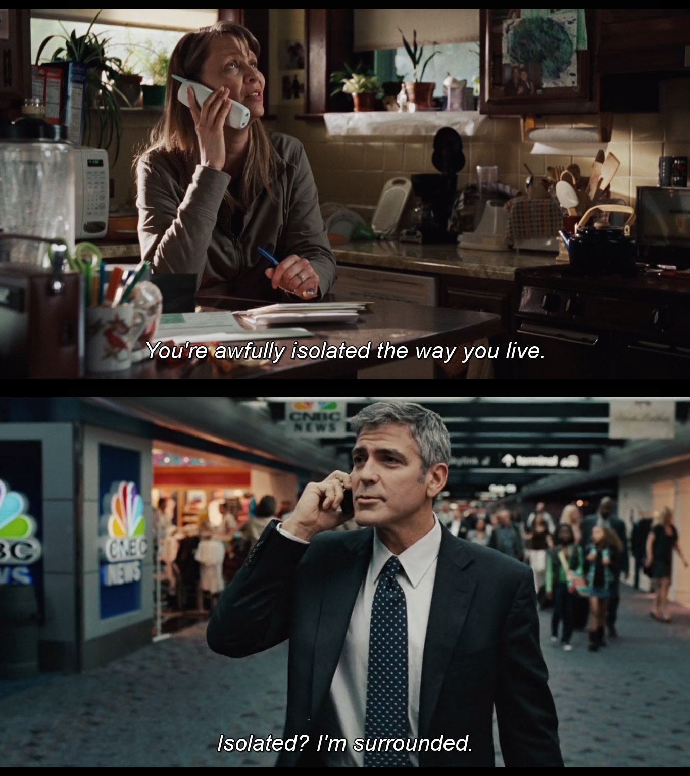
Notes:
He neglecting his family ties.
He is not understood by the few family members that are still in touch with him.

Slide 18
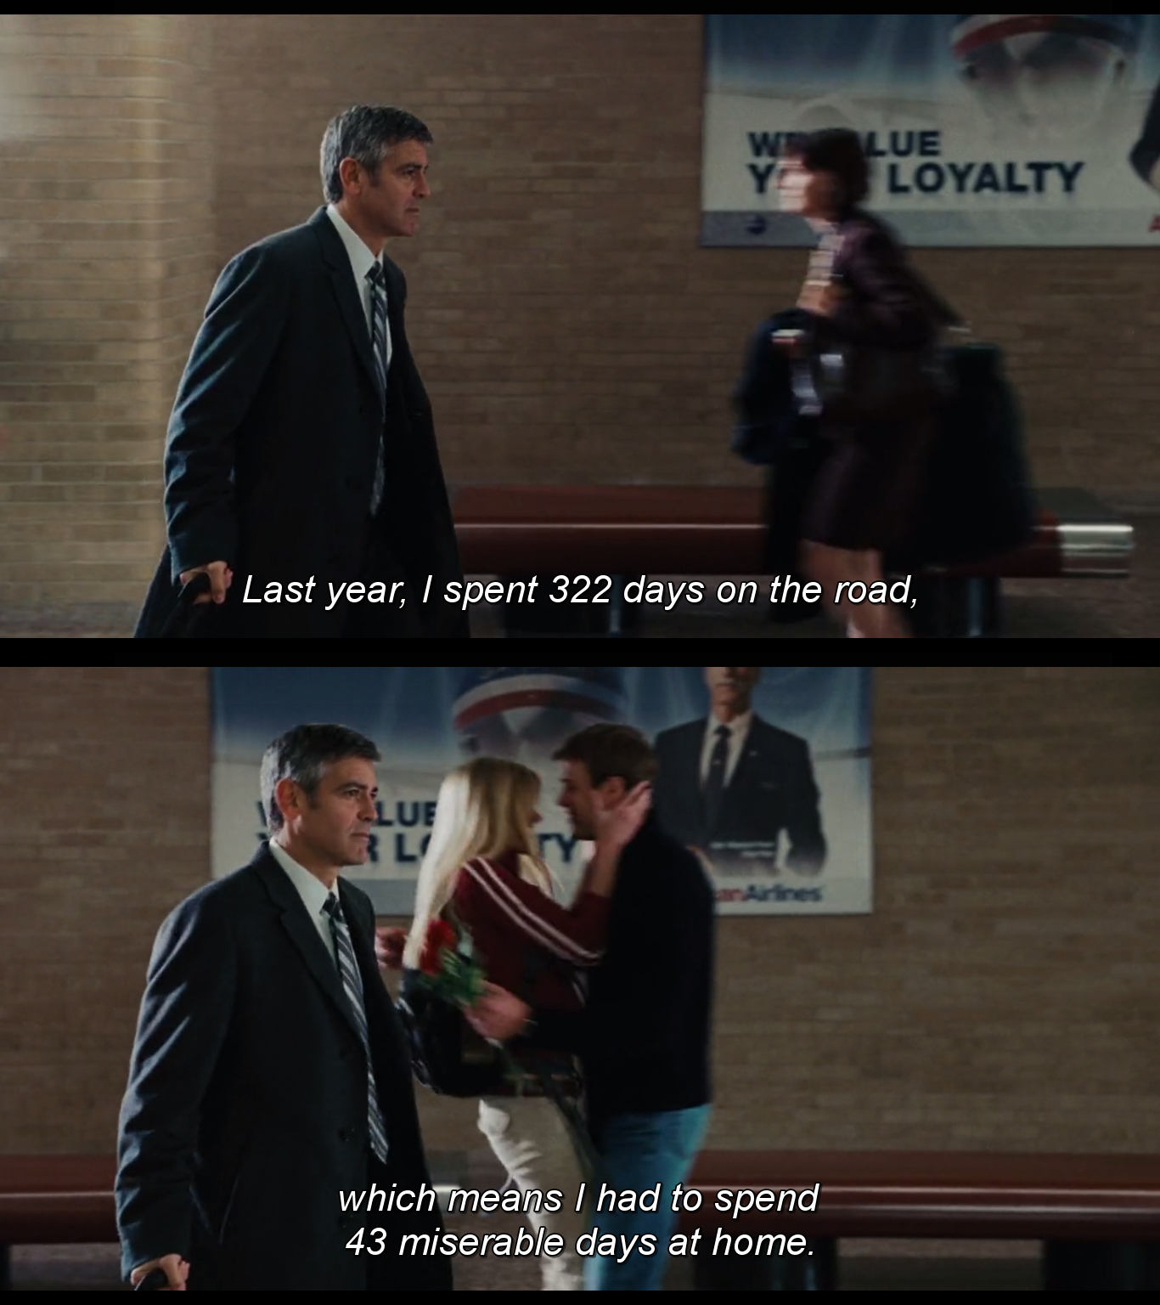
Notes:
For him, the concept of home is a very different thing.

Slide 19
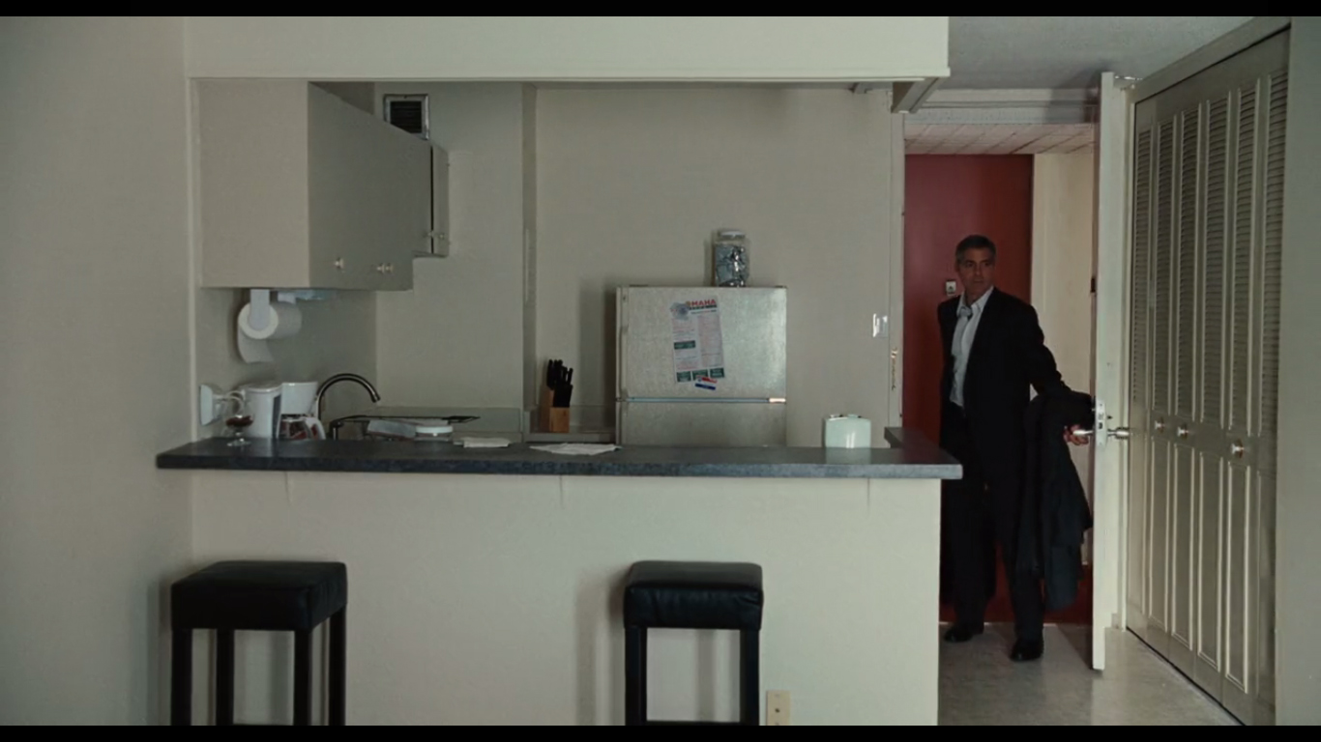
Notes:
For this type of contemporary residential transience figure home is nothing more than a “knot”.
It is an abstract point of connection in a dynamic path that needs to insure fluidity to its user more than any sense of belonging.

Slide 20
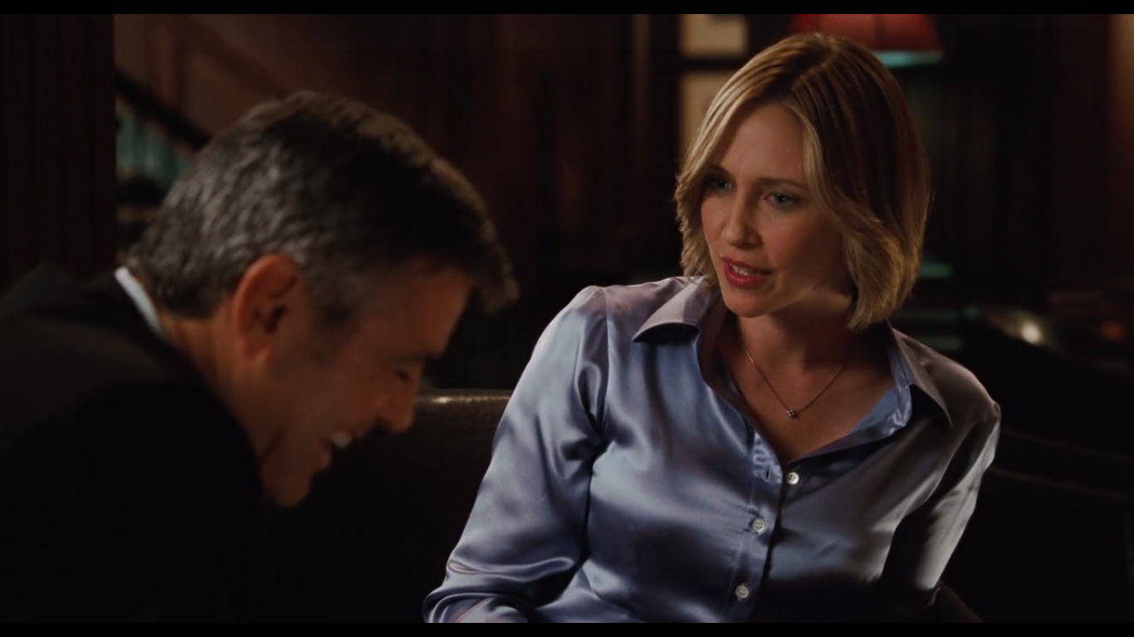
Notes:
Just like in the example given in “Lost in Translation”, his “living room” are semi-public or public spaces,

Slide 21
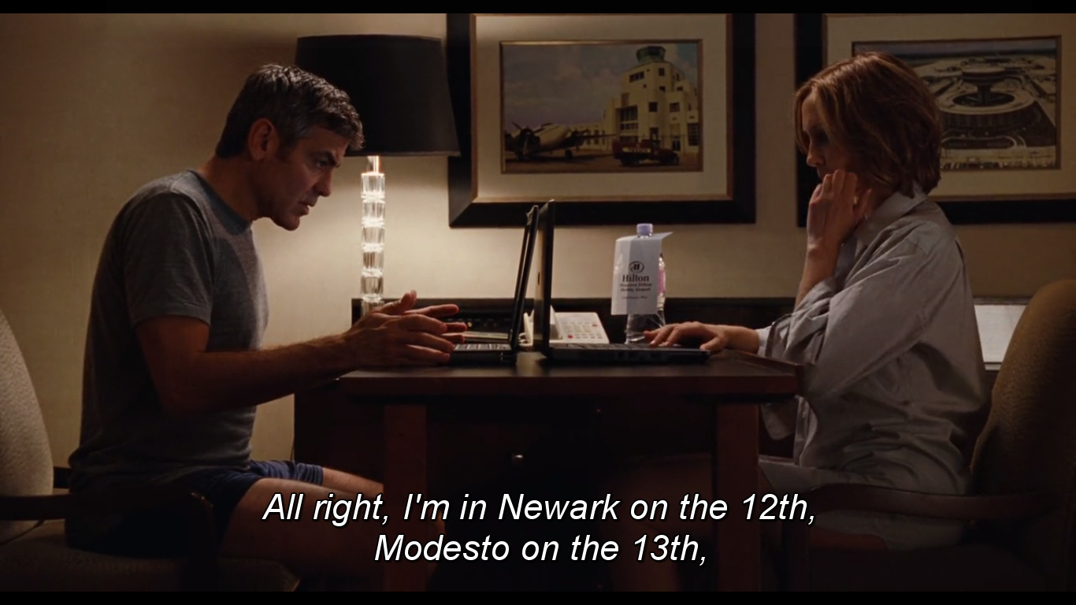
Notes:
and the territory where intimacy is developed is not in a particular private place but all along the before mentioned fluid path.

Slide 22
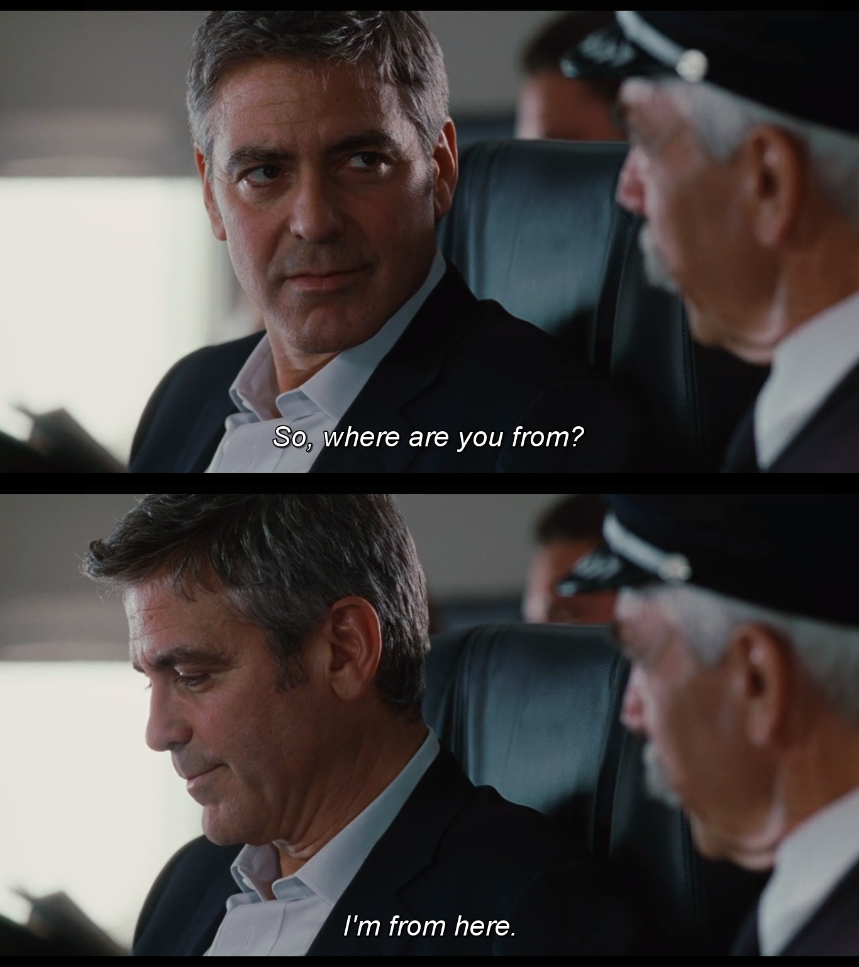
Notes:
The story develops and at the end of the movie the figure of residential transience faces his own isolation right before finally hitting his life goal, the 10 million miles mark. The fact that he is the youngest person to hit that mark is symptomatic of this intensity in mobility.

Slide 23
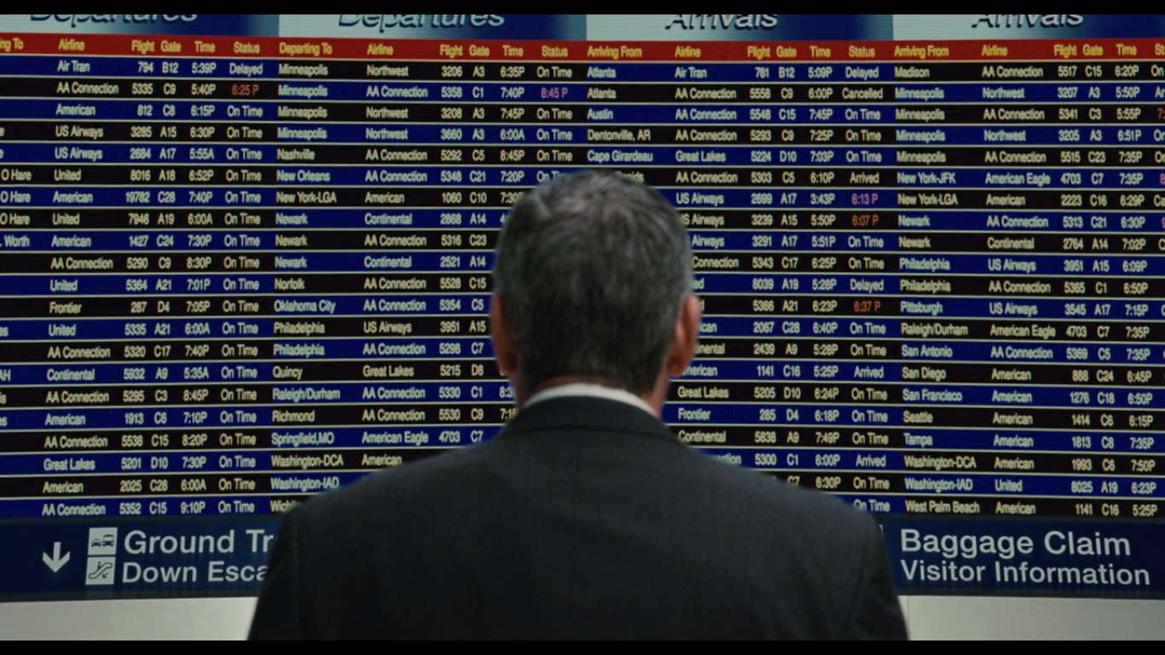
Notes:
An intensity in an exterior territory that, just like in Charlotte's and Bob's case makes them look inwards.

Slide 24
Le Voyage du Ballon Rouge (2007)
Notes:
And finally, “Le Voyage du Ballon Rouge”.
In this movie the director Hou Hsiao Hsien explores different external territories:

Slide 25
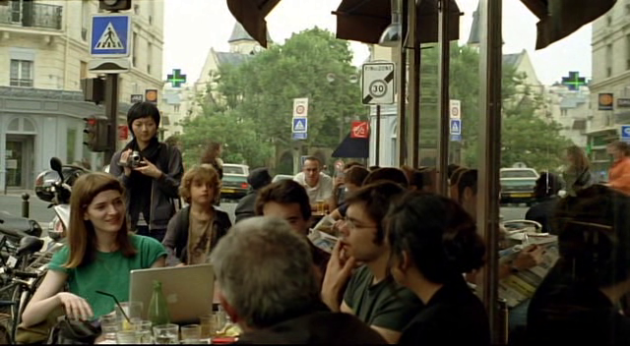
Notes:
The Paris of contemporary times.

Slide 26
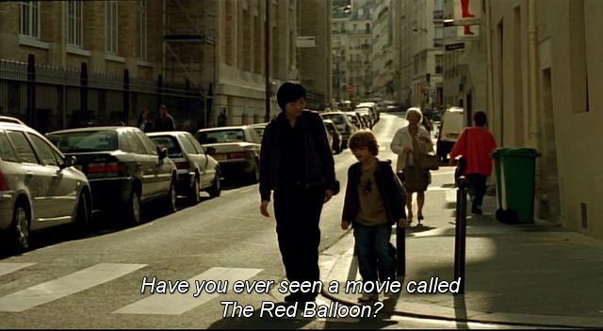
Notes:
And the past existing Paris represented in Albert Lamorisse's 1958 movie “Le Voyage du Ballon Rouge”.

Slide 27
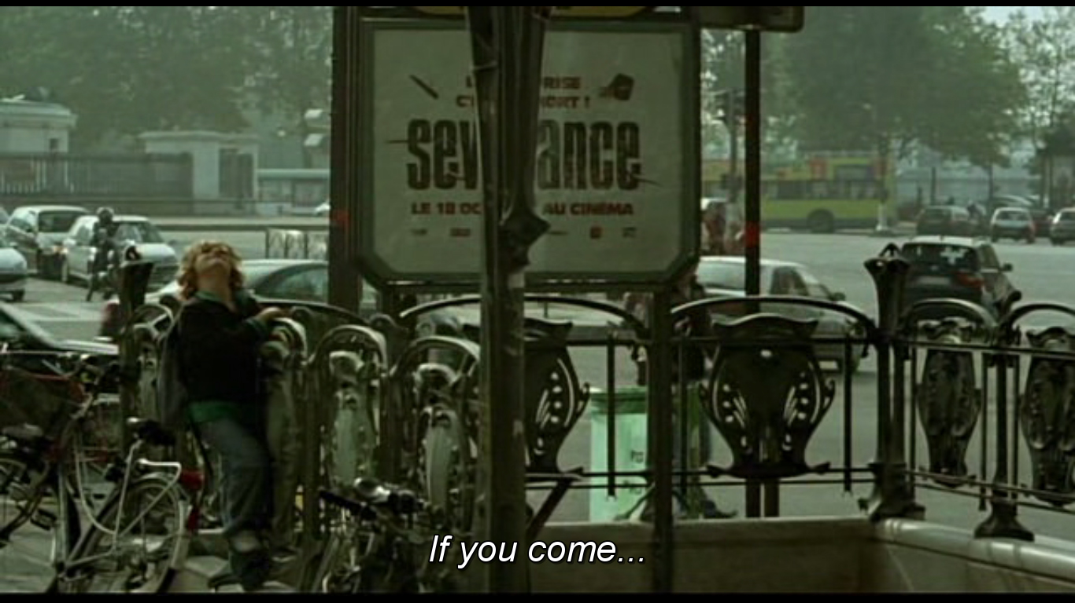
Notes:
Simon is a little boy who lives with his mom in a small apartment in Paris. His mother's boyfriend lives in Canada. He has a step sister who lives in Brussels. A nanny from China is hired to take care of Simon.
It is through this boy and his path in this city that the nanny ends up shooting a video with the same title as Albert Lamorisse's film.

Slide 28
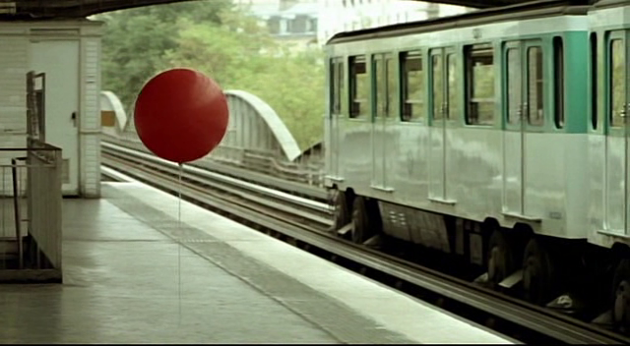
Notes:
For me, and for this purpose, the interest of this movie is related with 3 aspects.
The first one is because it draws an image on a reality that is more and more common in most cities, and specifically in Paris. And this is the intense mobility shared by many citizens.
It's not that there was not mobility in the past, but it is just more often and it has more distant origins.

Slide 29
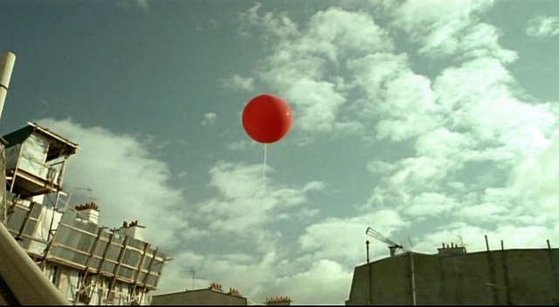
Notes:
The second aspect is related with the symbolism of the “relationship” between the boy and the balloon.
He is a lonely small boy, in a big city, who has a mother who is not always around, part of the reason because she is always working. In a way both are chasing a balloon. Maybe this is just a reflection on the individualism so omnipresent.
One could say that it is as uncommon to see such a young boy exploring this urban territory as it is uncommon for a middle aged man to travel 10 million miles flying.

Slide 30
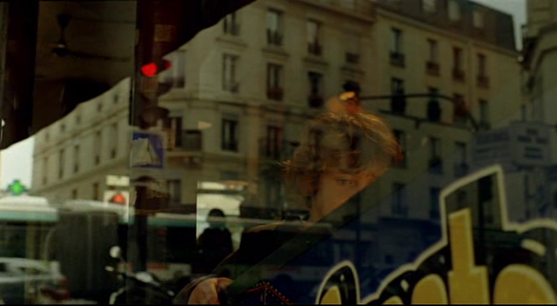
Notes:
I do not think though that this should be seen in a pejorative way. On the contrary. It can be seen as a way of consciously understanding the full capabilities of an individual in his context.

Slide 31
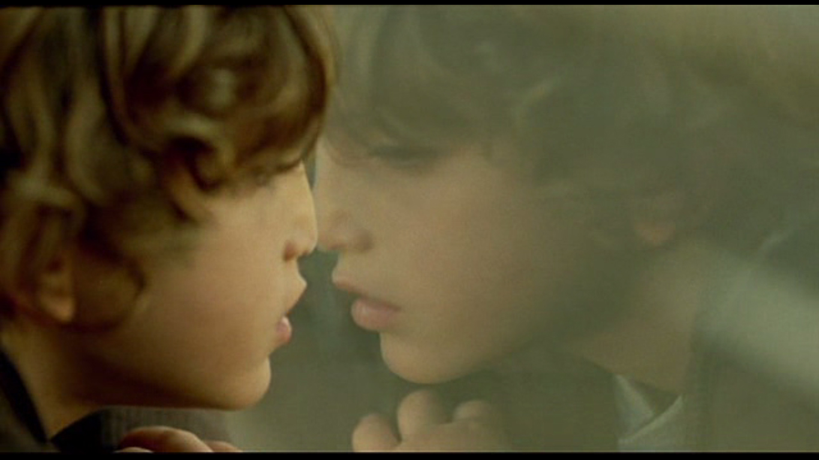
Notes:
In this way, Simon is an interesting example of an individual who disrupts the idea a traditional personal development. He is a premature flâneur in a fragmented non-traditional family, living in a wide and diverse territory.

Slide 32
Notes:
So, the question I have is:
If these were the real people that you were designing for, what would you do? Can you change anything in reality? Is there a need? Can architects do anything for them?

Slide 33
“People can inhabit anything. And they can be miserable in anything and ecstatic in anything.
More and more I think that architecture has nothing to do with it.
Of course, that's both liberating and alarming.”
Rem Koolhaas

Slide 34
Notes:
Lost in Translation is considered to be - by its director Sofia Coppola - a “study in emotional and geographical dislocation”.

